Slide 1
Revo Apps Sales Oct 2013 - Jan 2014
Muhamad Rayhand Prasetya

Slide 2
Questions
Who is your audience
Head of Sales
What she cares about as head of sales
Sales increasing and decreasing and what causes that, top product and lowest product
How to best address her needs
Provide information about top sales of product and monthly sales of product
What actions does she needs to take
Implement strategy for increasing sales of product

Slide 3
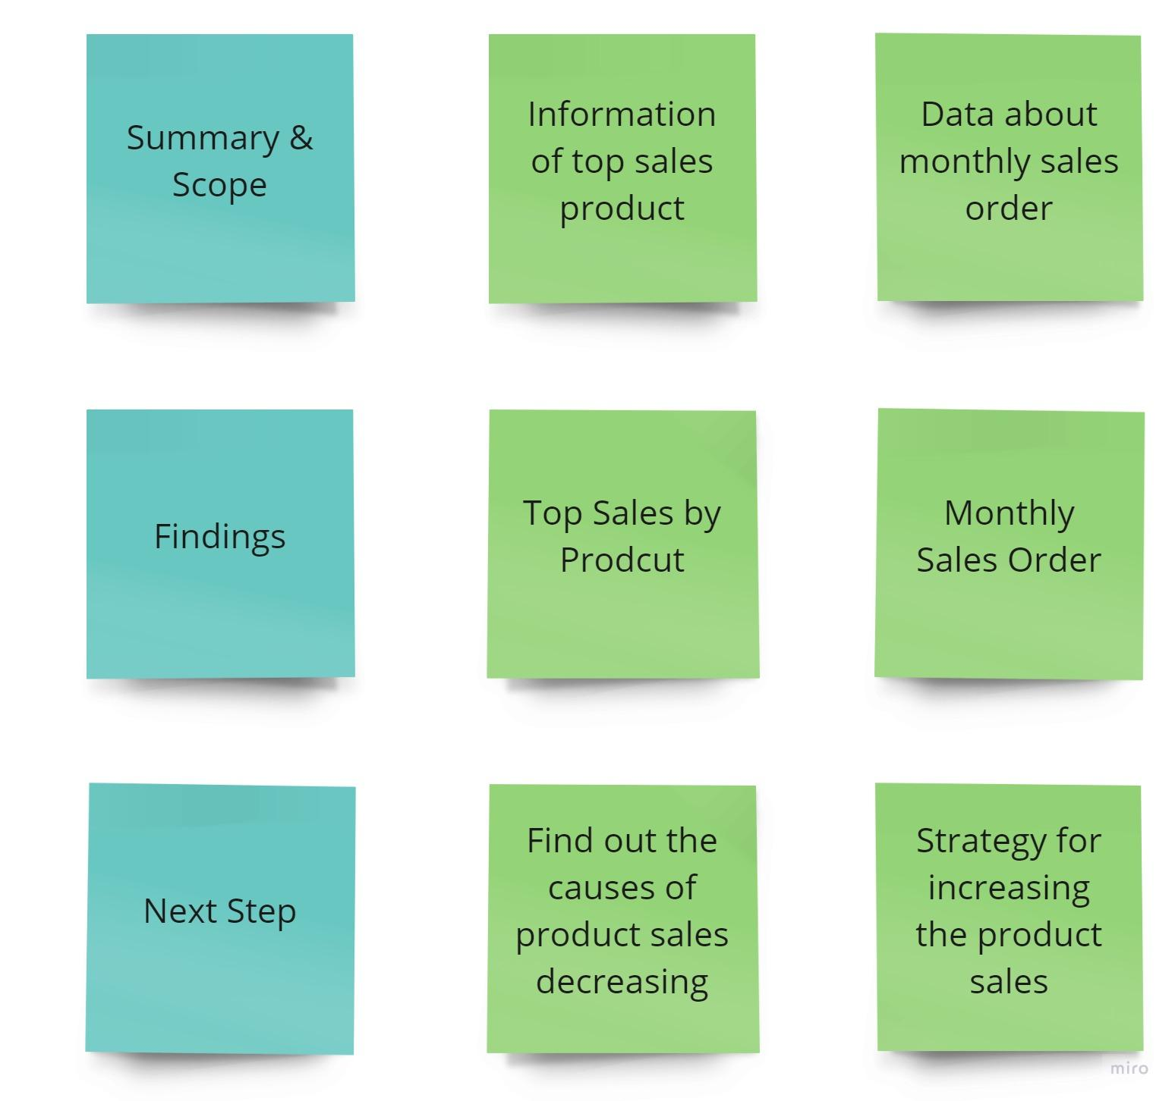
Storyboard

Slide 4
Summary & Scope
The total products sold for 4 months from October 2013 - January 2014 were around 34,493 products from around 1914 total orders.
The product category with the highest sales is Clothing, which is around 889 orders.

Slide 5
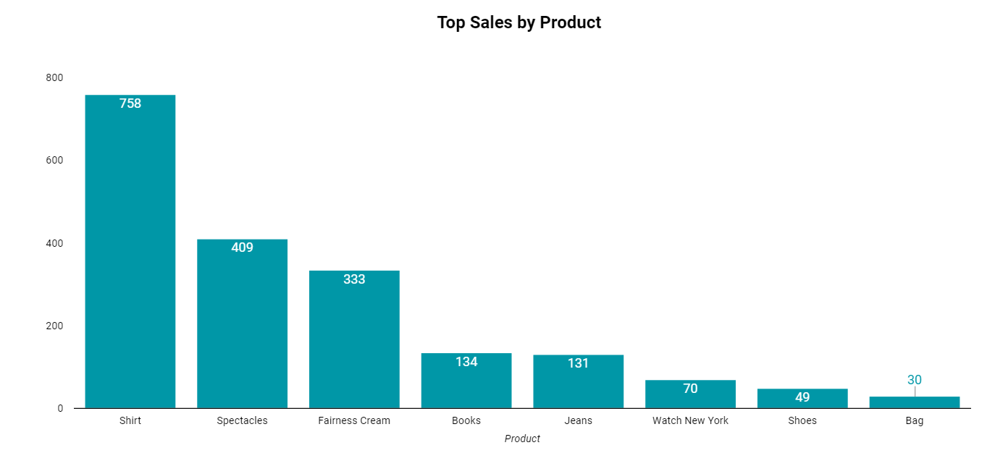
Top sales of product from Oct 2013 - Jan 2014 by number of order
The highest product sales were found in Shirt with 758 orders, followed by Spectacles and Fairness Cream with 409 and 333 orders.
The lowest product sales were found in Bag which only had 30 orders.

Slide 6
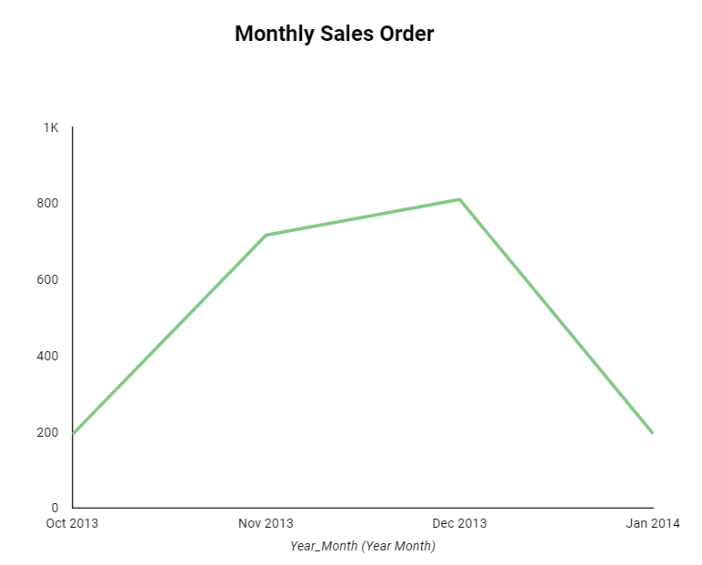
Monthly sales order from Oct 2013 - Jan 2014
Product sales had a significant increase from Oct 2013 - Dec 2013.
From Dec 2013 - Jan 2014 product sales have decreased drastically.

Slide 7
Next Steps
Find out the reason why product sales in Dec 2013 - Jan 2014 decreased.
Find and implement strategies to increase product sales.

